Slide 1
Game Programming
Homework 0
I3B03 周宛蓁
410306203

Slide 2
URL of jsfiddle
https://jsfiddle.net/jean11231/f97mjyda/

Slide 3
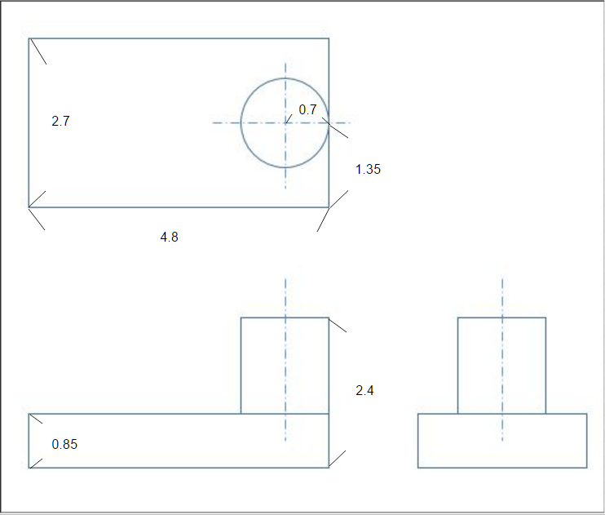
工程圖

Slide 4
測試過程

